Slide 1
MATHEMATICS OF NATURAL INTELLIGENCE
Dr. csi., Prof. Evgenii Vityaev
Sobolev Institute of Mathematics,
The Artificial Intelligence Research Center of the Novosibirsk State University

Slide 2

Academician K.V. Anokhin. The Cognitome: Seeking the fundamental neuroscience of a theory of consciousness. Neurosci Behav Physi, 51, 2021
The problem is not that the existing neurophysiological theories are imperfect... the correlative approaches used in them simply cannot answer questions about the nature of the mind and subjective experience. … This requires a non-reductionist fundamental theory.
Notes:
Первым таким принципом является понятие задача, цель и результат, которые одновременно были сформулированы, как в математике, так и в теории функциональных систем.

Slide 3
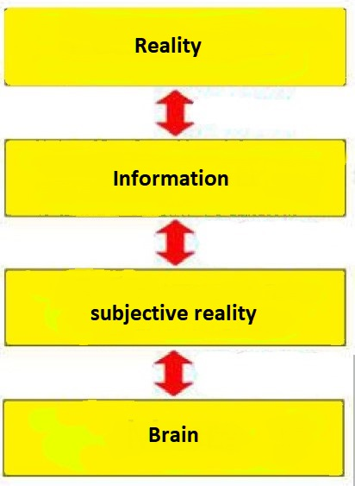
Informational approach to the «brain-main» problem by D.I.Dubrovsky
Consciousness has a specific and inherent quality of Subjective reality (SR).
Subjective reality is the reality of an individual's conscious states – sensations, perceptions, feelings, thoughts, intentions, desires, etc.
The problem of "consciousness and the brain" can be considered as the problem of "subjective reality and the brain“.
Requires a conceptual system linking the phenomena of SR with brain processes
Informational approach:
The information is embodied in its physical medium.
Information is invariant relative to its physical carrier.
Subjective Reality can be considered as information related to the corresponding brain process as its carrier.

Slide 4
Principles of the information theory of consciousness construction
This is an information theory of anticipating events from the outside world. If the outside world were random, then no anticipation of it would be possible. But our world is well structured and these structures need to be used.
The information theory of the reality reflection should be based on the laws of the external world structure and simultaneously describe both the information structure of reality and the neurophysiological and other mechanisms that ensure the reflection of this structure.
The brain had to evolutionarily form such neurophysiological mechanisms that would automatically capture and use these structural laws of the external world to anticipate it.
Notes:
Первым таким принципом является понятие задача, цель и результат, которые одновременно были сформулированы, как в математике, так и в теории функциональных систем.

Slide 5
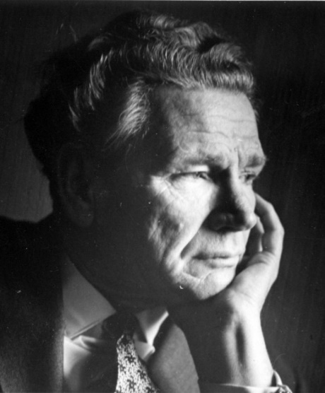
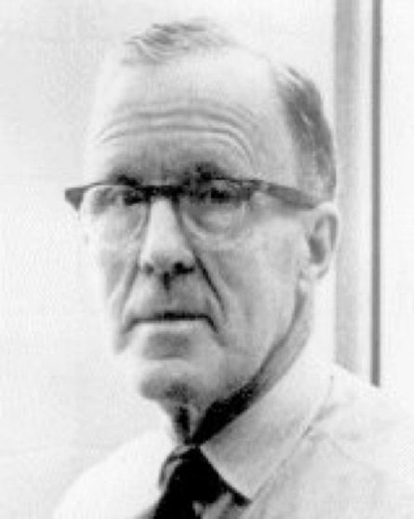
K.V. Anokhin. COGNITIOM – toward a unified theory of Brain and Mind.
COGNITIOM – is a cognitive (subjective) reality hidden from our direct perception and manifested in phenomenology and behavior. Cognitome consists of two types of Cognitive Groups (COGs).
Natural Intelligence – Cognitom model.
P.K. Ahokhin
D.O.Hebb
Cogs generalizing representations of P.K.Anokhin's theory of functional systems.
COGs of the phenomenal experience generalizing D. Hebb's cellular ensembles.
The basic principle: The brain discovers all possible causal relationships in the outside world and draws all possible conclusions from them.
Explains the structure and functions of functional systems COGs.
Explains the structure and functions of the COGs of phenomenal experience.
Based on the information laws of the external world it ensures maximum accuracy of the reality anticipation.
Notes:
Когнитом - это
Сначала рассмотрим формализацию когов второго вида.
С нашей моей точки зрения рассмотрение когов феноменального опыта
невозможно без формализации самой воспринимаемой реальности и закона ее строения.
Мозг фактически максимально точно настраивается на закон строения реальности и использует его для адекватного отражения самой реальности.
Такая формализация нами осуществлена на основе формализации «естественной» классификации и «естественных» понятий.

Slide 6
Causality
In the philosophy of science, causality is reduced to prediction and explanation:
"causality means predictability ... in the sense that if the complete previous situation is known, the event can be predicted ... if all the facts and laws of nature related to the event are given."
The causal relation reduce to the inference of predictions from the available facts and laws.
There are two types of predictions (explanations):
1. Deductive-Nomological (D-N), based on facts and deterministic laws;
2. Inductive-Statistical (I‑S) based on facts and probabilistic laws.
DEDUCTIVE-NOMOLOGICAL MODEL
INDUCTIVE-STATISTICAL MODEL
[r]
L₁,…, L_{m} – set of laws; C₁,…,C_{n} – set of facts;
G – explicable/predicted statement;
L₁,…,L_{m}, C₁,…,C_{n} ⊢ G; L₁,…, L_{m}, C₁,…,C_{n} consistent;
L₁,…, L_{m} ⊬ G, C₁,…,C_{n} ⊬ G;
L₁,…, L_{m} laws have only quantifiers of universality,
C₁,…,C_{n},G – quantifierless formulas.

Slide 7
Statistical ambiguity problem: In inductive statistical inference, two opposite statements can be deduced.
(L1) - ‘Almost all cases of streptococcus are quickly cured by penicillin injection’;
(L2) - ‘Almost always penicillin-resistant streptococcal infection is not cured after penicillin injection’;
(C1) - ‘Jane Jones got sick streptococcal infection’;
(C2) - ‘Jane Jones received a penicillin injection’;
(C3) - ‘Jane Jones has penicillin-resistant streptococcal infection'.
Karl Hempel. Requirement of Maximal Specificity (RMS) :
Explanation 1 |  | Explanation 2
Л1 | [r] | Л2 | [r]
C1,C2 |  | C2,C3
E |  | ¬E
Let K be a knowledge state, then for any class H for which the following two sentences are contained in K ∀x(H(x) ⇒ F(x)), H(a), there is exist in K a statistical law p(G;H) = r’ that r = r’.
Vityaev, E., Odintsov, S. How to predict consistently? // Trends in Mathematics and Computational Intelligence In: Studies in Computational Intelligence, 796, María Eugenia Cornejo (ed), 2019, 35-41.

Slide 8
Semantic probabilistic inference
Semantic Probabilistic Inference (SPI-inference) is the such sequence C₁,C₂,...,C_{n} of probabilistic laws C_{i} = (A^{i}₁&...& A^{i}_{ki} ⇒ G), i=1,…,n that:
the rule C_{i} is a subrule of the rule C_{i+1};
Prob(C_{i+1}) > Prob(C_{i}), i = 1,2,...n-1.
Theorem. A rule satisfy RMS iff it is the leave of the SPI-inference
tree and have a maximum of conditional probability.
A rule that satisfy RMS is called Maximally Specific Causal Relation (MSCR)
Theorem. I‑S inference dased on MSCR is consistent.

Slide 9
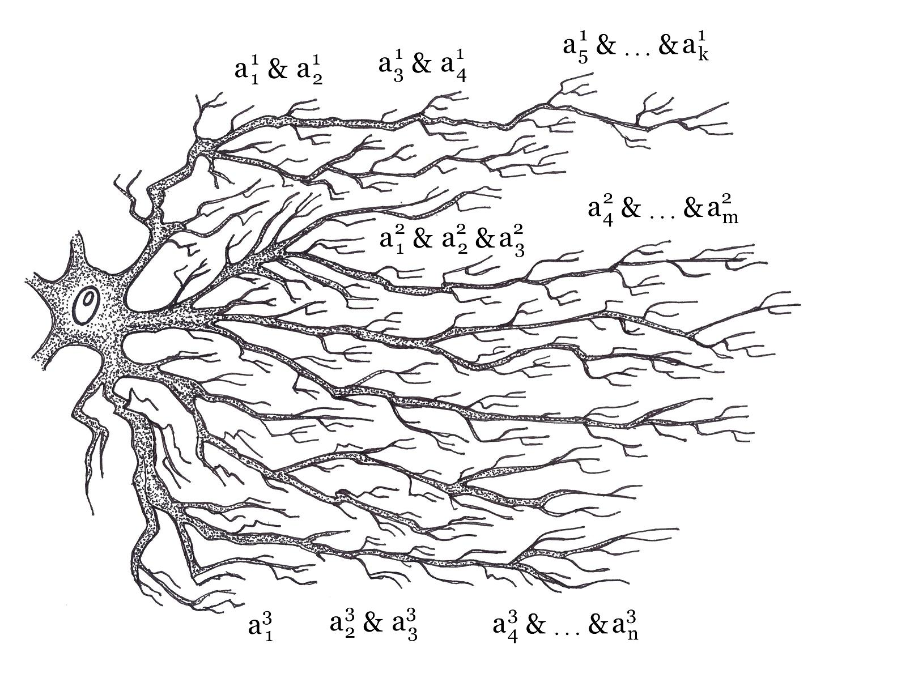
Semantic probabilistic inference may be presented as a formal model of a neuron satisfying the Hebb rule
G
The learning MSCR causal relations along the dendrites may be presented by semantic probabilistic inference – it add to the premise of causal relation all new features that are increase the conditional probability of the goal feature G excitation.
The first level of ensuring maximum accuracy of predictions
Vityaev E.E. A formal model of neuron that provides consistent predictions // Biologically Inspired Cognitive Architectures 2012. Proceedings of the Third Annual Meeting of the BICA Society. In Advances in Intelligent Systems and Computing, v.196, Springer. 2013, pp. 339-344.
Notes:
Нами предложена принципиально более точная модель нейрона, удовлетворяющая правилу Хебба,
основанная на специально разработанном семантическом вероятностном выводе.
В отличии от нейронных сетей, семантический вероятностный вывод обнаруживает полное множество
условных причинных связей на уровне нейрона.
Кроме того, нами строго доказано, что обнаруживаемые правила максимально специфичны и в пределе предсказывают без противоречий.
Поэтому данная модель максимально точна с точки зрения обнаружение причинных связей и предсказания.
Однако сложность обнаружения всех максимально специфических правил NP-трудна.
Но нейрон работает параллельно, поэтому легко справляется с этой проблемой.

Slide 10
Task approach. The concept of task in the foundations of mathematics
A TASK is defined (comprehended) if and only if we have a criterion of the task solution – a criterion for checking whether the presented solution is really a solution of that task.
In mathematical theories, such a criterion is usually considered to be a prof of the task solution. But this criterion is applied only when, within the framework of the formal system itself, we have both prof of the task solution and the ability to verify by means of the system itself that this proof is indeed a solution to the task.
It was proved that only in "weak" formal systems (for which Gödel's theorem does not hold) can we determine by means of the formal system itself whether a text is a proof of task or not.
Yu.L.Ershov, K.F.Samokhvalov. Modern Philosophy of Mathematics, 2007.
As a result, Hilbert’s program for substantiating mathematics is formulated differently: it is not necessary for all mathematics to prove its consistency — this is impossible and unnecessary. It is necessary to formulate and solve problems within the framework of weak formal systems.
Notes:
Первым таким принципом является понятие задача, цель и результат, которые одновременно были сформулированы, как в математике, так и в теории функциональных систем.

Slide 11
The concept of “Task" in cognitive sciences
A generalization of the task concept is the concept of a Goal. A goal cannot be achieved without a criterion for its achievement, otherwise one can always assume that it has already been achieved.
Therefore, the formulation of the goal should always be accompanied by a definition of the criteria of the goal achievement. Reaching the goal gives a certain Result.
The only physiological theory in which the Goal achievement and the Result obtaining is considered as the solution by the brain of the TASK to satisfy some need is the Theory of Functional Systems by P.K. Anokhin. This theory also reveals the physiological mechanisms for achieving the goal and solving the task by the brain.
“Perhaps one of the most dramatic moments in the history of the brain study as an integrative formation is the fixation of attention on the action itself, and not on its results ... we can assume that the result of the “grasping reflex” will not be grabbing as an action, but that totality afferent stimuli, which corresponds to the signs of the "captured" subject” P.K. Anokhin. “The totality of afferent stimuli” is the criterion for achieving the goal in TFS.
Therefore, a prerequisite for the purposeful behavior of an intelligent agent is goal-setting, including a criterion for achieving the goal.
Evgenii E. Vityaev Purposefulness as a Principle of Brain Activity // Anticipation: Learning from the Past, (ed.) M. Nadin. Cognitive Systems Monographs, V.25, Chapter No.: 13. Springer, 2015, pp. 231-254.
Goal ― Criteria of the goal achivement Result

Slide 12
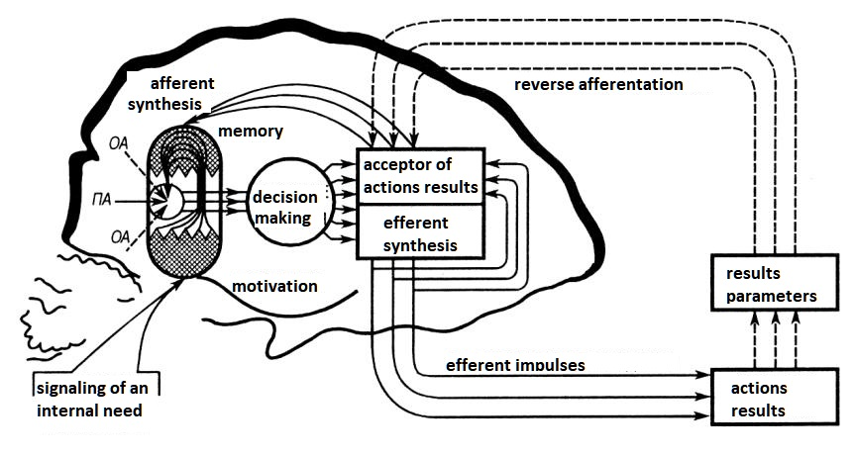
Evaluation of the achieved result of an action occurs with the help of an active orientation-research activity, which occurs in all cases when the result of a perfect action does not correspond to the properties of the acceptor of the action results.

Slide 13
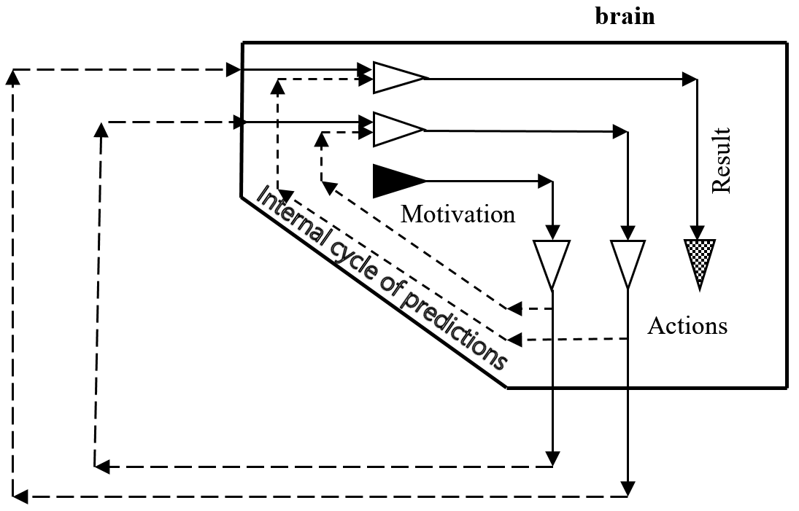
Causality and the Functional Systems Theory
"We are talking about the collateral branches of the pyramidal tract, which divert to many neurons "copies" of those efferent parcels that reach the pyramidal tract... Thus, the moment of decision-making and the beginning of the release of working efferent excitations (the beginning of actions) from the brain is accompanied by the formation of an extensive complex of excitations (acceptor of action results) consisting of afferent signs of the future result" P.K. Anokhin.
Notes:
Данная архитектура также может быть объяснена на основе обнаружения мозгом причинных связей и неподвижных точек.
Ещё в работах П.К.Анохина было обнаружено, что …

Slide 14
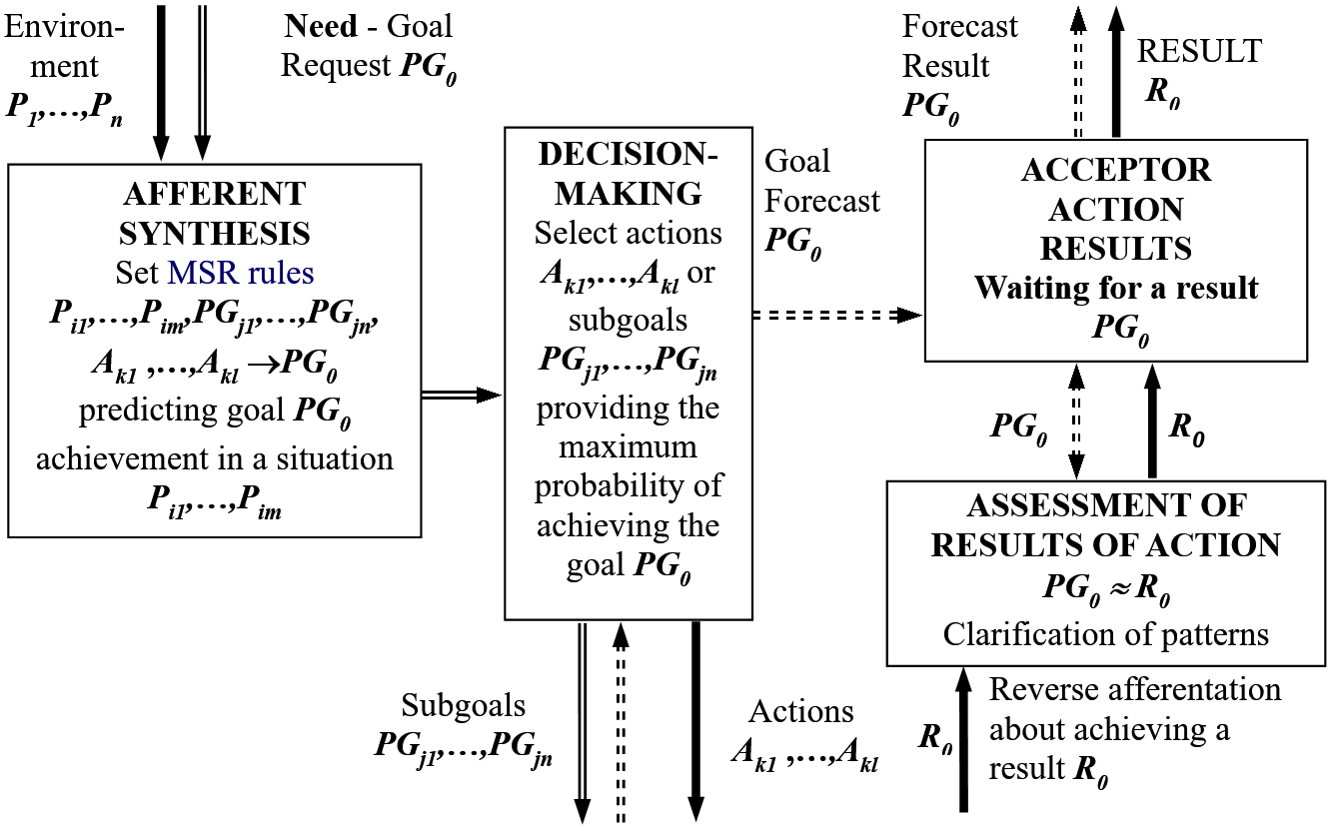
FUNCTIONAL SYSTEMS OPERATION SCHEME
Notes:
Рассмотрим как после некоторой формализации принципов целеполагания и предсказания,
сформулированных в Теории Функциональных Систем можно формально представить основную схему работы функциональных систем.

Slide 15
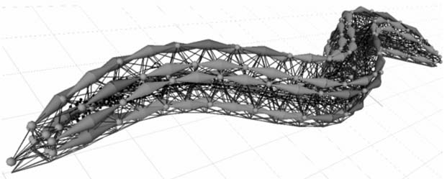


Slide 16
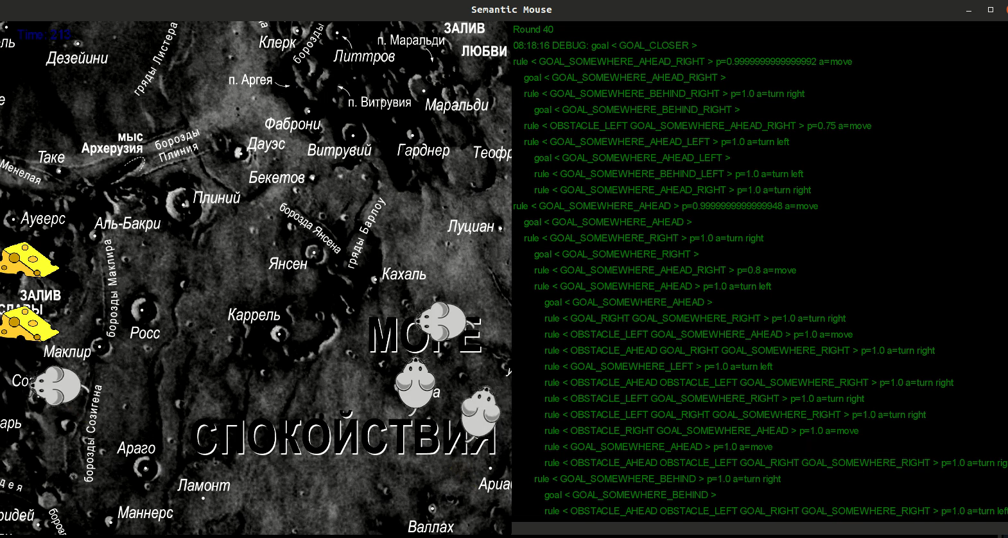
https://www.youtube.com/watch?v=985Fw3yKeOM

Slide 17
What is TASK in general case
The task is defined only if there are:
• subject domain to which the task belongs, knowledge about the subject domain, recorded in the form of its model, including a description of the signature and structure of the domain description language, a set of terms and concepts (ontology), initial data, facts and knowledge written in terms of ontology ;
• to which request, formulated in the task, to the subject domain should we get an answer;
• the criterion for satisfying the request is defined – it is determined in which case it can be considered that a response to the request has been received;
• in what context should we look for the answer to the request – what do we expect from the result and what are its consequences and what to do if the answer is negative.
In the task approach the purpose of AI is automation of task solving, understanding the “automation” as formulation of the requests/solutions in terms of executable specifications.
The ∑-definability of computations was chosen as the basic model of computations and verifying the truth of ∑-formulas on a constructive model M and its list superstructure HW(M).
Yu.L. Ershov, S.S. Goncharov & D.I. Sviridenko, “Semantic programming” // Information Processing 86: Proceedings of the IFIP 10th World Computer Congress, IFIP* Congress Series, vol. 10, Elsevier Science, Dublin, 1986, pp. 1093–1100.
Goncharov S.S., Sviridenko D.I. Theoretical aspects of Σ-programming. Lecture Notes in Computer Science, 1986, v.215, p.169–179.
Goncharov S.S., Sviridenko D.I. Σ-programming / Transl., II. Ser., Am. Math. Soc., 1989, v.142, p.101–121.
Goncharov S.S., Sviridenko D.I., Vityaev E.E. On the task approach in artificial intelligence // Siberian Journal of Philosophy. 2019.V. 17, No. 4. (in Russian)

Slide 18
Task-driven approach
Task-driven approach – is a generalization of the functional systems theory of the brain in organization of purposeful behavior of the organisms and humans.
Task-driven approach – is an anthropomorphic variant of the Artificial Intelligence, that is Natural Intelligence.
Task-driven approach – is a Natural variant of the General Artificial Intelligence – General Natural Intelligence, as it oriented on the rather wide and general set of tasks.
Task-driven approach – Executable artificial intelligence. The tasks to be solved are formulated in terms of executable task specifications. After the task specification, you get the algorithm for calculating the task.
Task-driven approach – Trusting artificial intelligence. The specification of the problem and its solution are carried out in terms of the ontology of the subject area.
Notes:
Первым таким принципом является понятие задача, цель и результат, которые одновременно были сформулированы, как в математике, так и в теории функциональных систем.

Slide 19
Cellular ensembles by D. Hebb Formalization
«NATURAL» classification – information law of the structure of world objects.
Artificial classification is based on signs.
Natural classes (animals, plants) are described by a potentially infinite set of features.
The taxonomic problem is the “indication": from a potentially infinite number of features, go to a limited number of indicator features.
The Information Law of "natural classes": a potentially infinite number of features of "natural" classes are connected by an exponential number of causal relationships.
"Natural" concepts in cognitive sciences
The principle of categorization of "natural" concepts (Eleanor Rosch): The structurality of the perceived world: “The perceived world is not an unstructured set of equally likely attributes. On the contrary, the material objects of the world are perceived as having... a highly correlated structure. ... combinations of what we perceive as attributes do not occur uniformly. Some pairs, triples, etc. are highly probable... others are rare; others are not logically or empirically found.”
Notes:
We begin with the natural classification of the real world objects.

Slide 20

The highly correlated attribute structure generates class prototypes.
Theory of causal models (causal-model theory, Bob Rehder).
The relation of an object to a category is based on the similarity of the generative causal mechanism. Bob Rehder suggested describing causal models by deploying Bayesian networks, but they do not support cycles. Formalization of causal models – probabilistic formal concepts.
The brain makes all possible conclusions about causal relationships.
Reflecting the highly correlated structure of objects in the external world, the detected causal relationships of "natural" objects loop on themselves in the process of inference, forming a certain "resonance" of causal relationships, which automatically forms cellular ensembles of simultaneously excited neurons generating causal models that form "prototypes" of the objects class.
Notes:
Информационная избыточность реальности была подтверждена в когнитивных науках,
При анализе процесса категоризации.

Slide 21
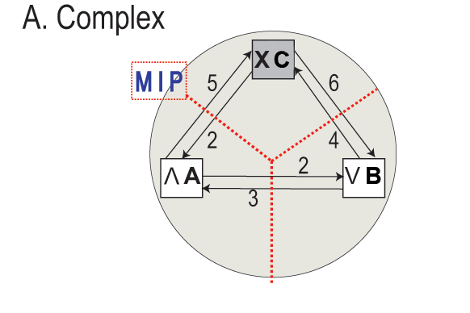
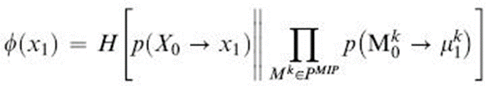
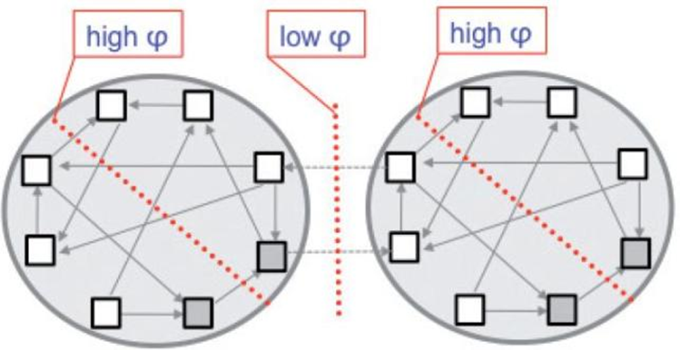
G. Tononi: Сonsciousness as integrated information
What we need to know is how much information is generated by the system as a whole, over and above the information generated independently by its parts – integrated information.
A subset S of X forms a complex when it enters state s₁ if φ(s₁) > 0 and S is not contained in some larger set with strictly higher φ.
Подмножество S системы X формирует комплекс, когда перейдя в состояние s₁ c φ(s₁) > 0 не найдется надмножества со строго большей φ.
At each instant in time any system of elements can be decomposed into its constituent complexes, which form its fundamental units. Любая система элементов может быть разложена на составляющие ее комплексы.
Neural cells ensembles corresponding to complexes
Notes:
За комплексом раздражителей скрывается закон строения нашего мира, который состоит в следующем.

Slide 22
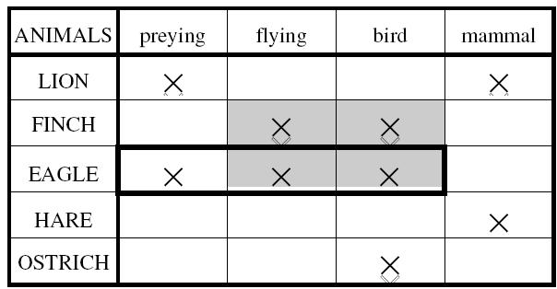
Formal concept analysis
Formal context K = ⟨G, M, I⟩,
G – objects, M – attributes, I – object-attribute relation
Derivation operator ,
and ,
Formal concept in the context K = ⟨G, M, I⟩ is a pair
A is the set of all objects from G having all the attributes of B, and B is the set of all attributes from M, which are valid for all objects of A.
Notes:
Here the main definitions of the formal concept analysis
Formal context, Derivation operator,
Formal concept is a pair where
Here two examples of concepts.

Slide 23
Probabilistic generalization of formal concepts
Steps of generalization:
Turn to account the definition of the formal concepts as a fix-points of implications.
Generalize the implications to a special type of probabilistic causalities that possess the following important properties:
satisfying Cartwright's definition of probabilistic causality:
maximal specificity;
Generalize the formal concepts as a fix-points of this causalities.
Prove the theorem that fix-points of this causalities are consistent.
Define a “natural” classification and “natural” concepts as a fix-points of these causalities.
Each class will then be described by its own set of maximally specific causal relationships that enter into a fixed point. Therefore, the prediction of the properties of objects of this class will be more accurate if it is based on the causal relationships of the class.
The second level of ensuring maximum accuracy of predictions
Vityaev, E., Odintsov, S. How to predict consistently? Trends in Mathematics and Computational Intelligence In: Studies in Computational Intelligence, 796, Cornejo Piñeiro, M.E., Kóczy, L.T., Medina, J., de Barros Ruano, A.E. (Eds.), 2019, 35-41
Notes:
Our unified formalization base on the probabilistic generalization of the formal concepts analysis.
The plan of generalization have the following steps

Slide 24
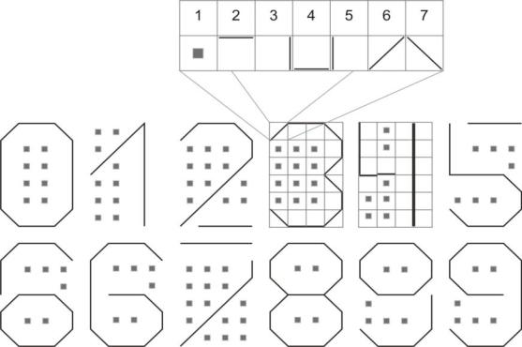





Fix-points of digits
1 | 2 | 3 | 4
5 | 6 | 7 | 8
9 | 10 | 11 | 12
13 | 14 | 15 | 16
17 | 18 | 19 | 20
21 | 22 | 23 | 24
Notes:
This experiment illustrate the fix-points formation.
Let us code the digits as shown on the slide.
At the bottom there are causal relations that are true on all digits.
We give thirty exemplars of each digit and reshuffle them.
Thus we have 360 reshuffled exemplars of digits.
Then we start the program to find all fix-points.
The program discovered exactly 12 fix-points corresponding the initial digits.

Slide 25
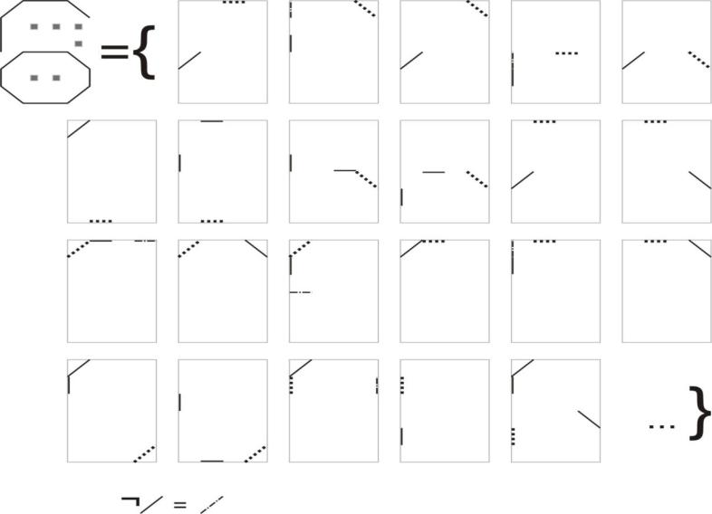
Fix-point of digit 6
Regularities use an attribute negation
Notes:
There where discovered 55089 causal relations on all digits.
Here the example of fix-point of the digit 6

Slide 26
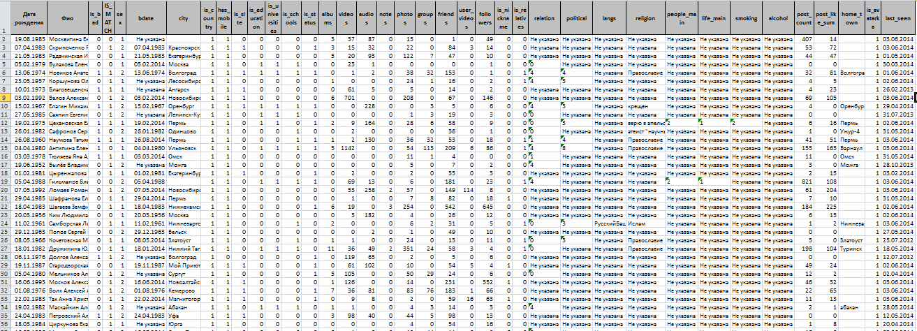
Contexts formation by probabilistic formal concepts
A verbal context is a complete passage of written/oral speech (text), the meaning of which clarifies the meanings of the words included in it. A situational context is a situation that includes an environment, time, place, etc., (afferent synthesis) that helps to interpret the meaning of statements more accurately. Functional systems are the most common contexts of needs and related objects of suitable functionality: knives can be kitchen, canteen, combat, stationery.
Contexts, as well as classes, allows for the most accurate predictions.

Slide 27
Types of social network users
IF sex = 2 (мужчина)
AND relation = 6 (в активном поиске)
AND people_main = 2 (главное в людях — доброта и честность)
THEN friends_scaled = 2 (много друзей) r=0.888889, 8 of 9 cases
IF bd = 1 (указана дата рождения)
AND is_relatives = 1 (есть родственники)
AND relation = 5 (всё сложно)
THEN is_people_main = 1 (главное в людях — ум и креативность) [r=0.875, 7 of 8 cases]
21 probabilistic formal concepts as person types were found.
The 8th type can be described as a married woman living in her hometown, for whom the main thing in life is family and children, appreciates kindness and honesty in people, relatives are listed in the profile, negative attitudes towards alcohol and smoking, a small number of photos, videos, audio.
11th type, can be described as an unmarried man, perhaps a teenager, who also appreciates kindness and honesty in people, but the main thing for him in life is self–development, and he compromises with smoking and alcohol.

Slide 28
Thanks for your attention
Evgenii Vityaev Consciousness as a logically consistent and prognostic model of reality // Cognitive Systems Research, 2019 Elsevier, 59 (2020), 231-246.
Evgenii E. Vityaev Purposefulness as a Principle of Brain Activity // Anticipation: Learning from the Past. The Russian/Soviet Contributions to the Science of Anticipation, (ed.) M. Nadin. Cognitive Systems Monographs, V.25, Chapter No.: 13. Springer, 2015, pp. 231-254.
Витяев Е.Е. Математическая вероятностная модель когнитома и функциональных систем // Искусственный интеллект, алгебраическая биология и теория систем в математических исследованиях российских ученых. Том 1. Труды Совещания "Междисциплинарное взаимодействие алгебраической биологии, теории систем и искусственного интеллекта". Спец. выпуск журнала Биомашсистемы, том 5, № 1, январь-март, 2021 год, стр. 238-292.
e-mail: vityaev@math.nsc.ru
Scientific Discovery website:
http://old.math.nsc.ru/AP/ScientificDiscovery/
Notes:
Таким образом нами разработаны достаточно подробные схемы различных когнитивных процессов.
Сейчас мы в основном заняты экспериментальной проверкой наших схем.

Slide 29

Thank you for the attention
e-mails: vityaev@math.nsc.ru
Scientific Discovery website
http://www.math.nsc.ru/AP/ScientificDiscovery
Notes:
Таким образом нами разработаны достаточно подробные схемы различных когнитивных процессов.
Сейчас мы в основном заняты экспериментальной проверкой наших схем.

Slide 30
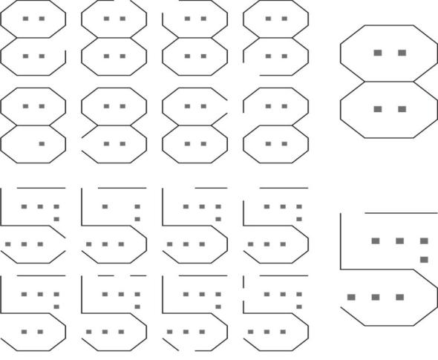
Digits with one random indeterminate feature
Notes:
Then we complicated the task and delete one random feature in every of the 360 reshuffled digits.
On this digits we discovered 73458 causal relations.
Then start the program for discovering all fix points.
The program discovered 14 fix-points including all 12 digits.

Slide 31
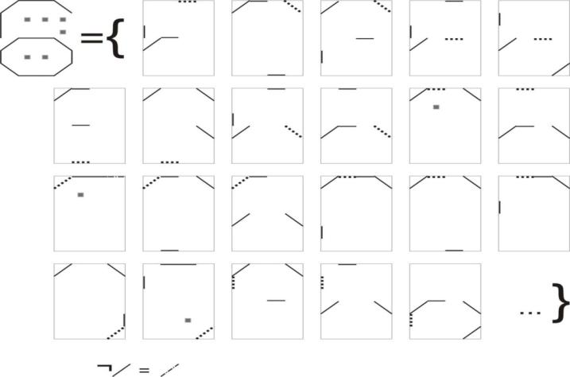
Notes:
There is the example of the fix-point of the digit 6.
Here regularities are more complicated and include more features in the premise.
The pattern of the digit 6 was discovered in despite of the absence of this pattern in the learning set.

